Slide 1

Apache Solr
Vijay Kumar NM

Slide 2

Lucene Wrappers (Apache Solr)
A Java wrapper over Lucene
A web application that can be deployed on any servlet container (Apache Tomcat, Jetty)
A REST service
It has an administration interface
Built-in configuration with Apache Tika (a repository of parsers)
Scalable
Integration with Apache Hadoop, Apache Cassandra

Slide 3
Lab
Install Solr
Start Solr
Directory Structure of Solr
Bin directory
Start Solr
Check status
Restart option
Admin Page

Slide 4
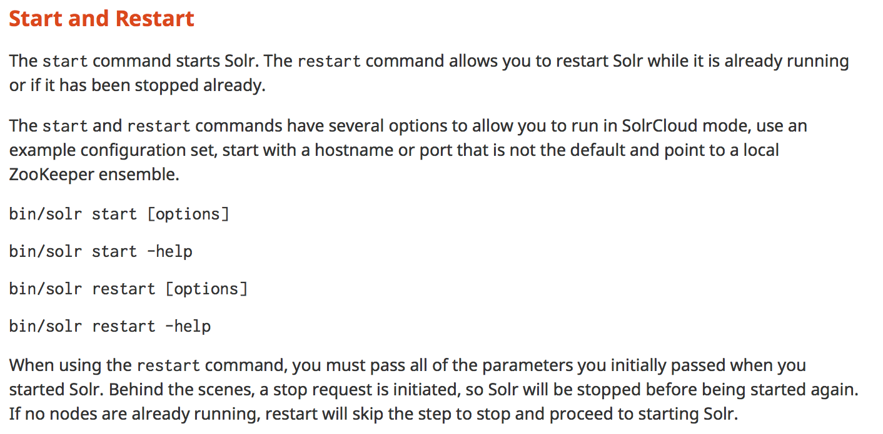

Slide 5
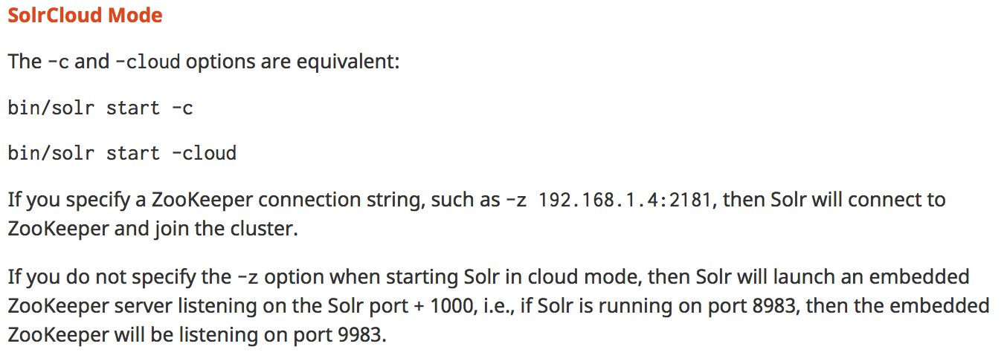

Slide 6
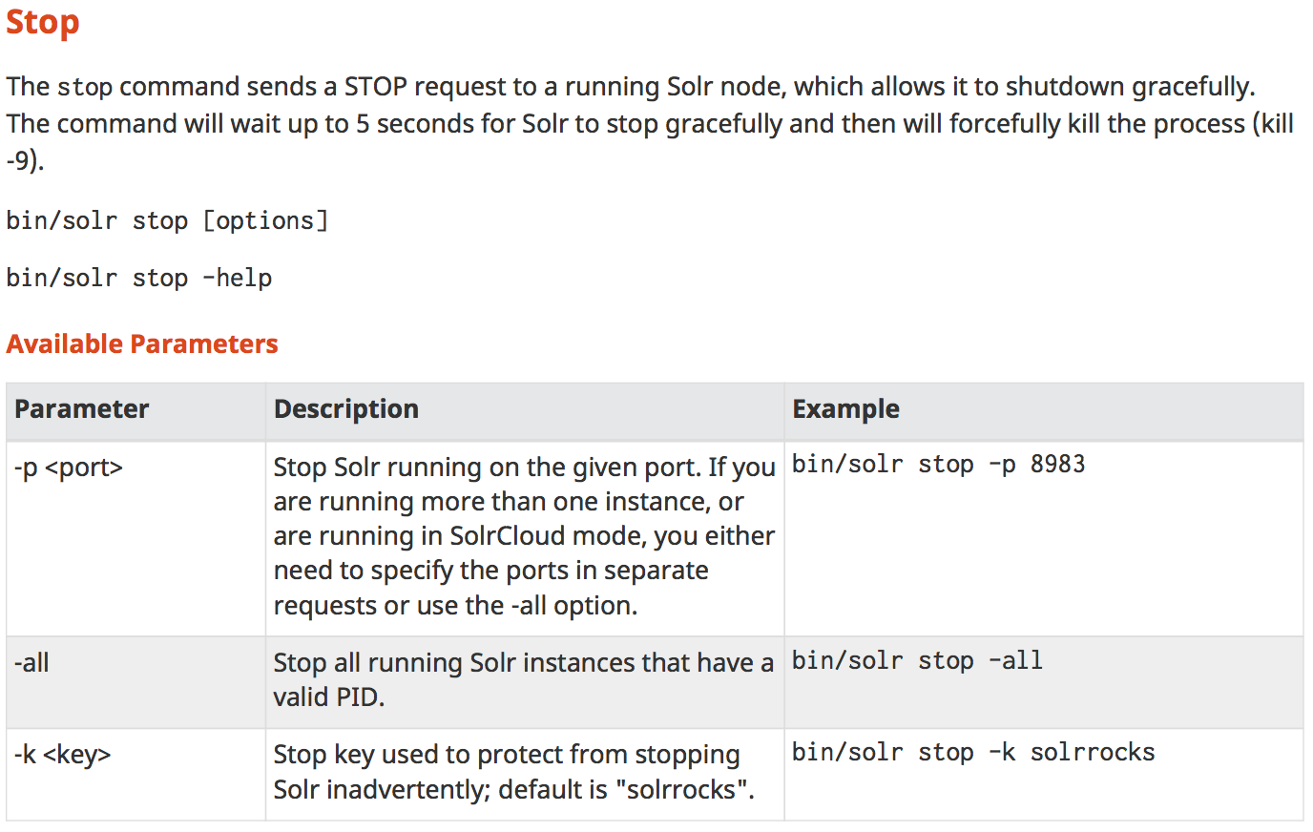

Slide 7
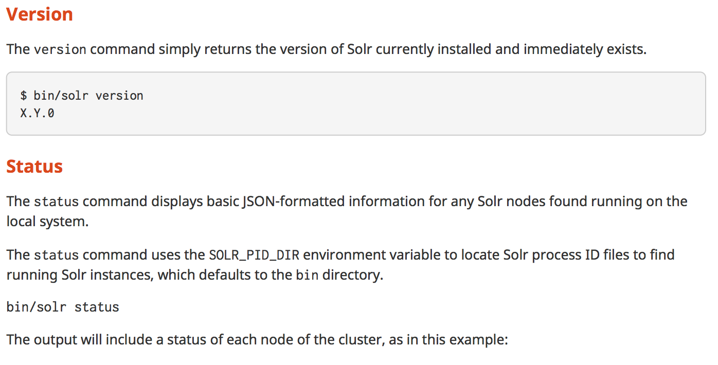

Slide 8
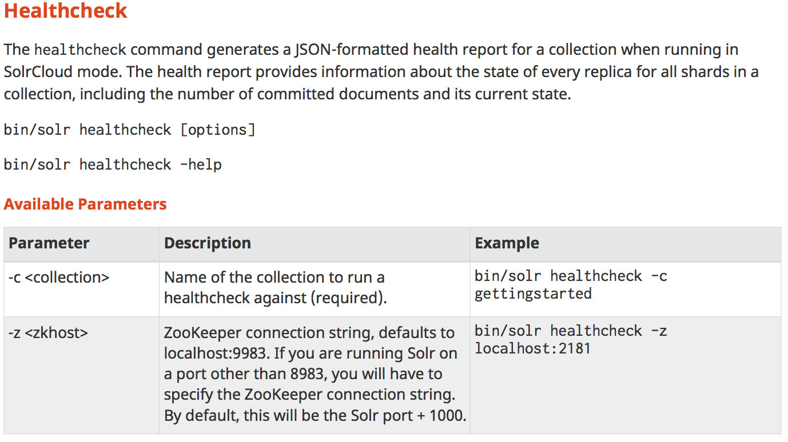

Slide 9
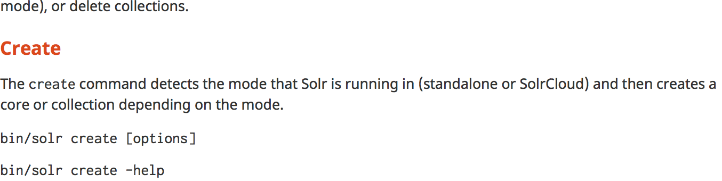
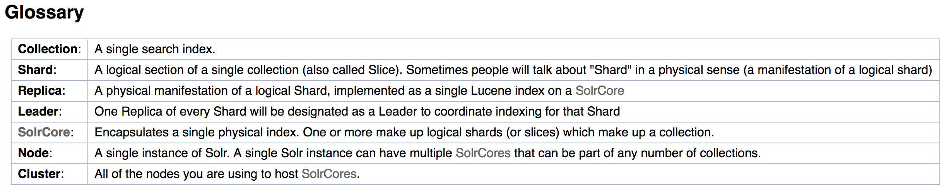

Slide 10
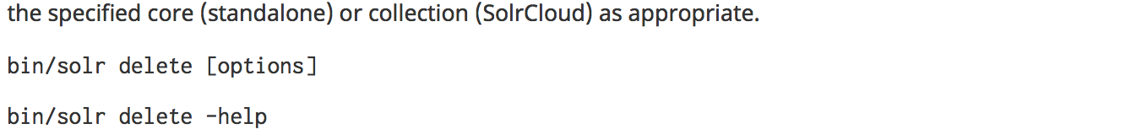

Slide 11
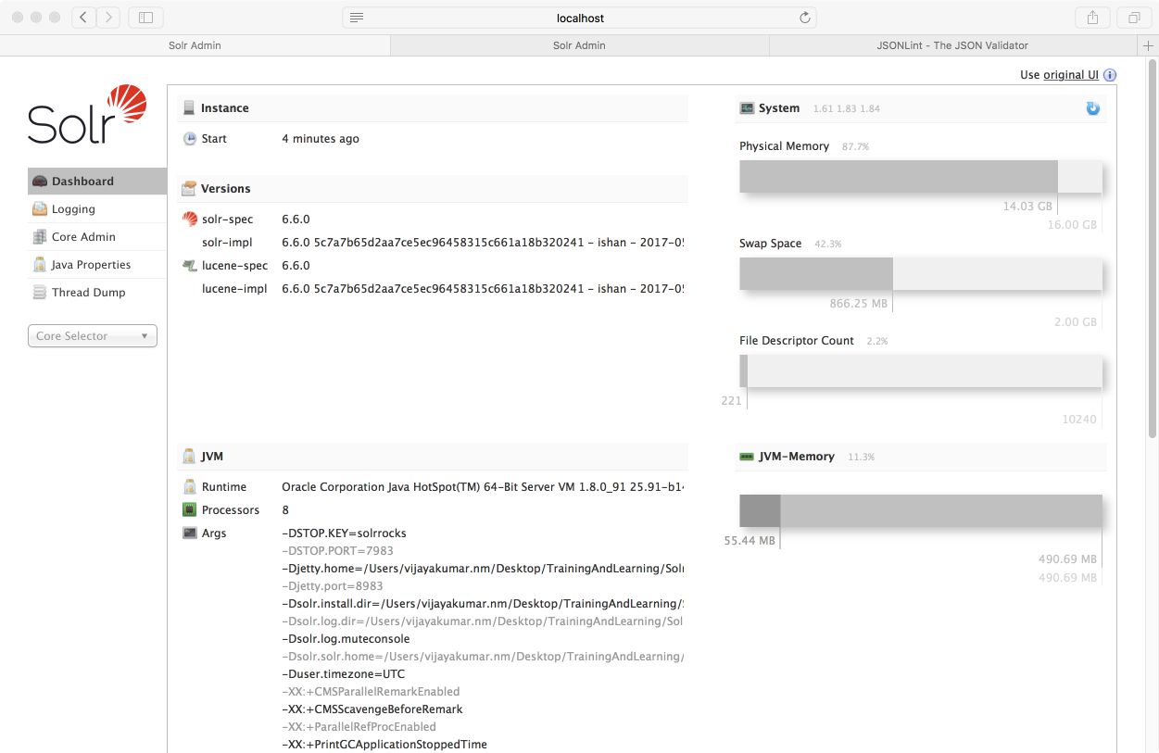

Slide 12
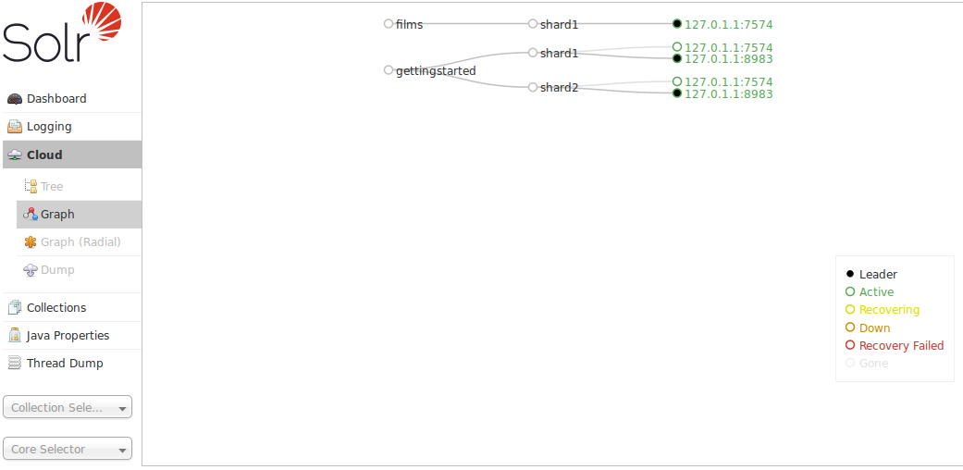

Slide 13
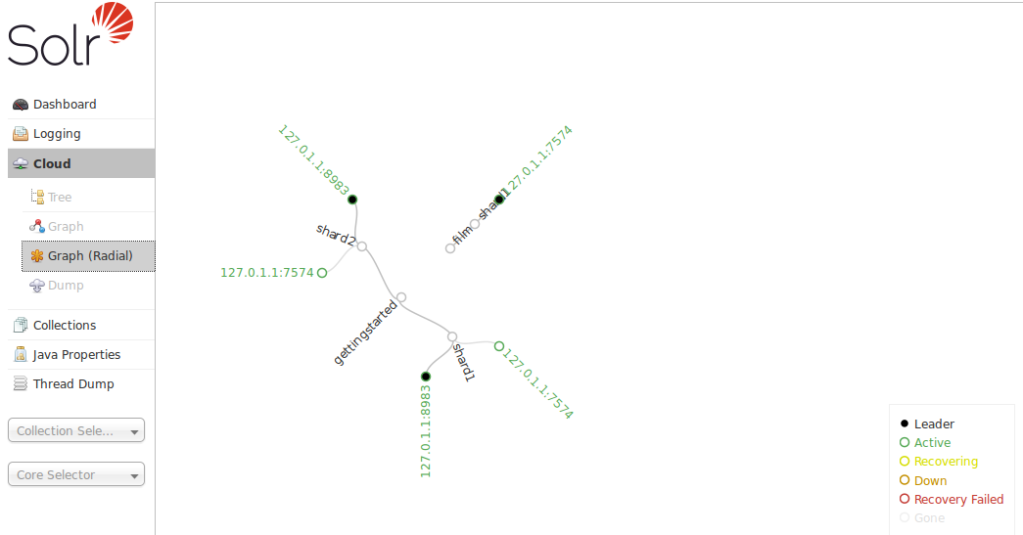

Slide 14
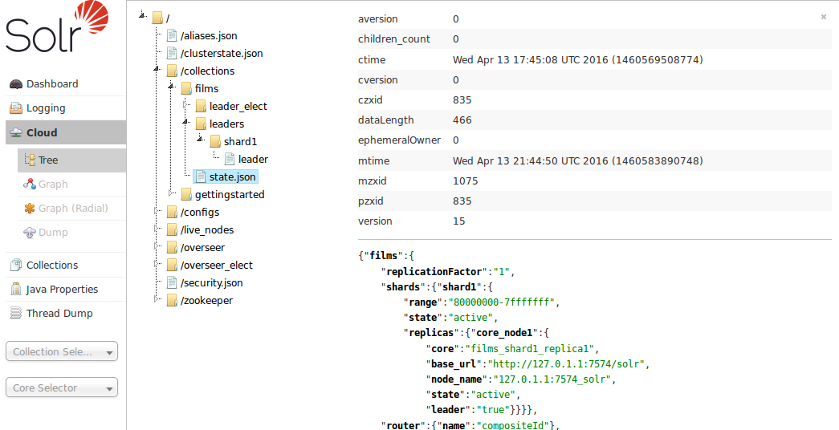

Slide 15
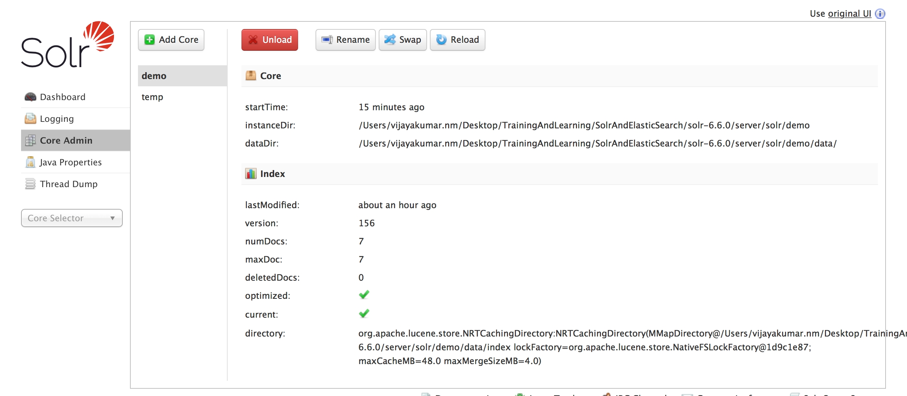
Collections / Core Admin

Slide 16
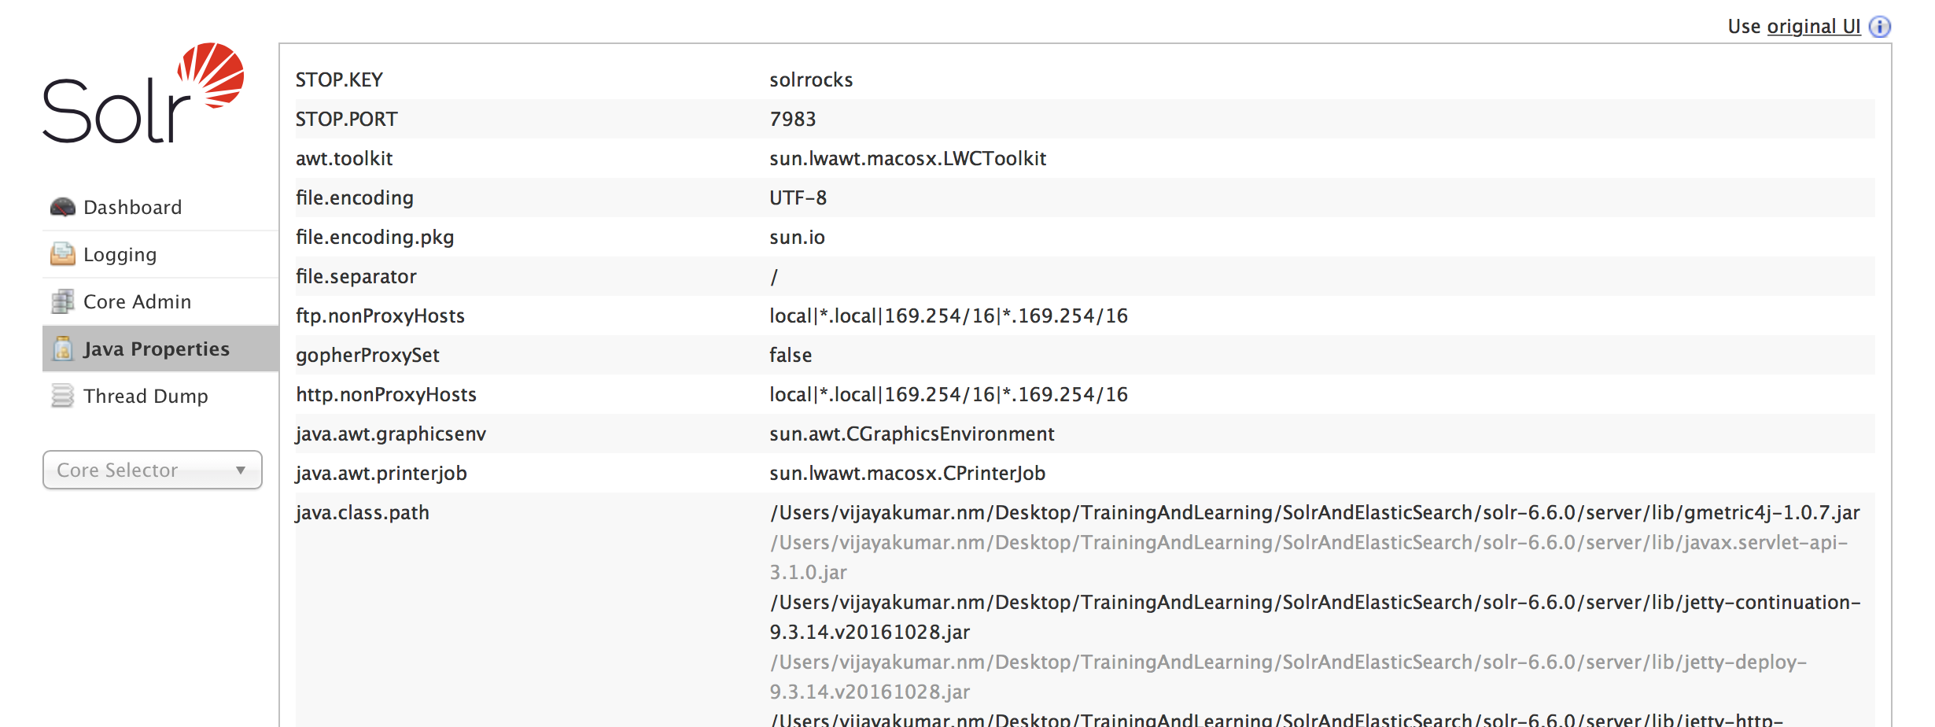
Java Properties

Slide 17
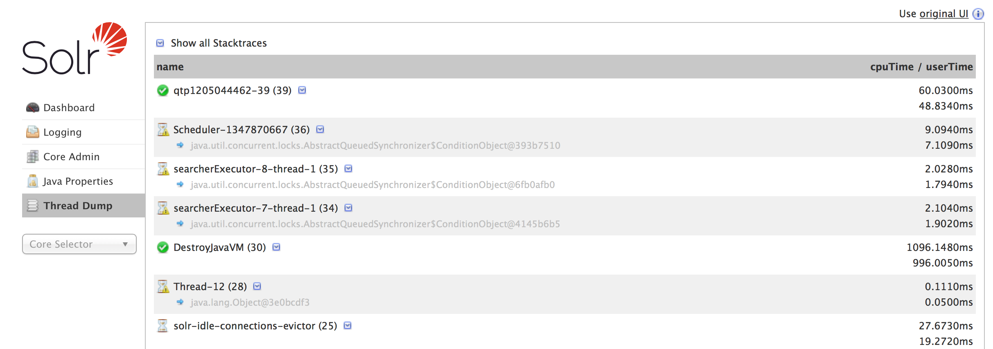
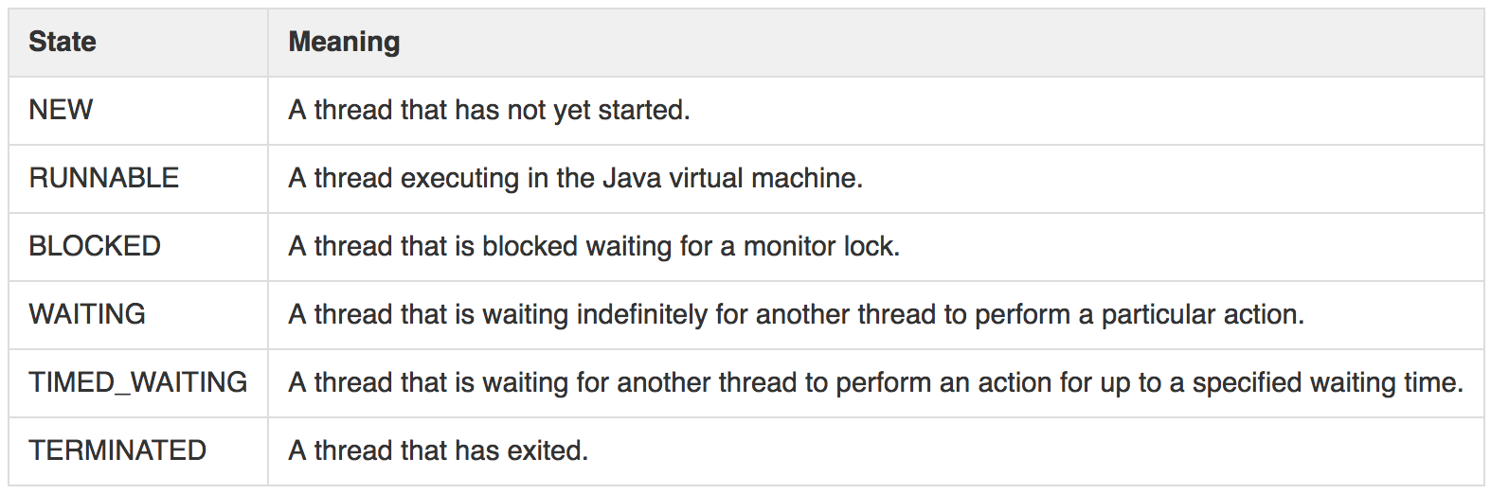
Thread Dumps

Slide 18
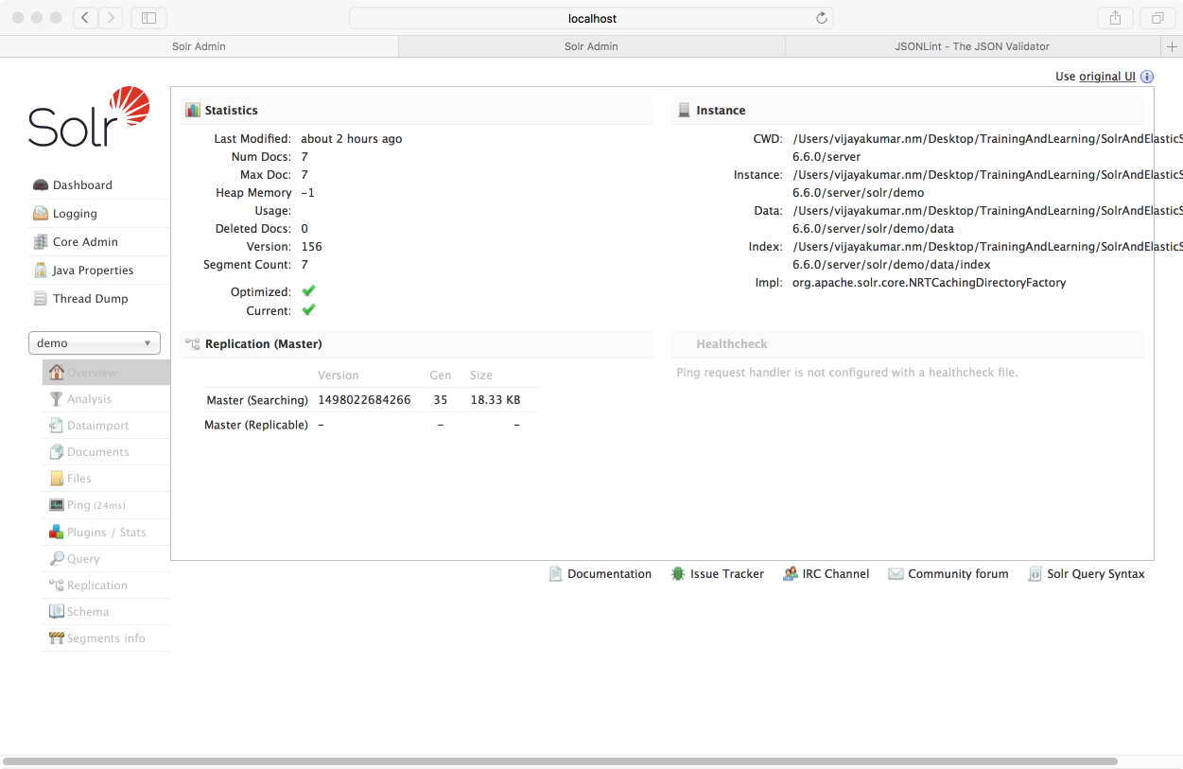
Core specific Tools

Slide 19
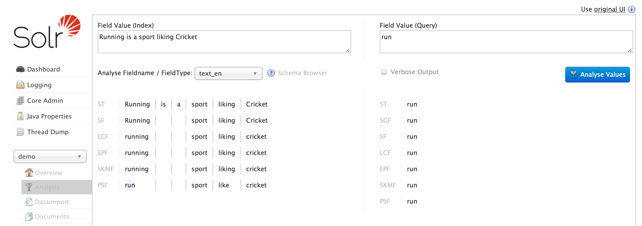
Analysis
You can analyze how content would be handled during indexing
or during query processing and view the results separately or at the same time

Slide 20
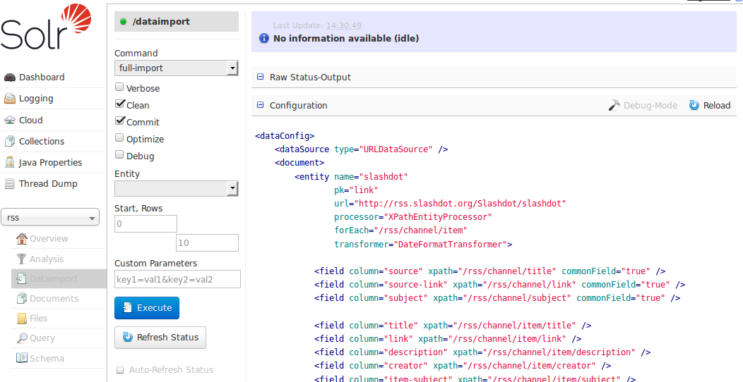
Data Import

Slide 21
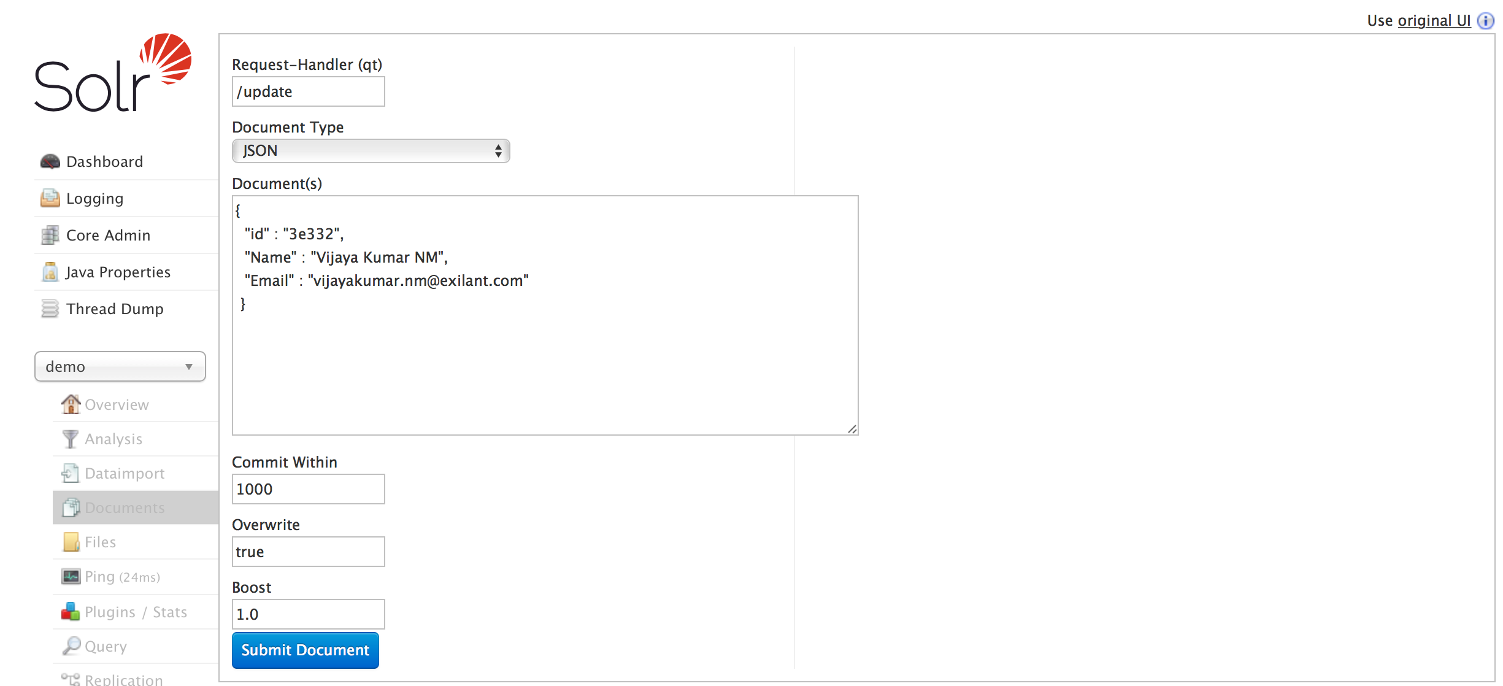
Documents Screen

Slide 22
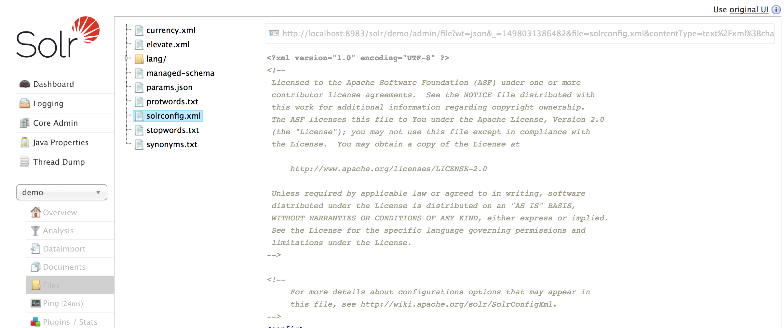
Files
For SolrCloud, the files displayed are the configuration files for this collection stored in ZooKeeper.
In a standalone Solr installations, all files in the conf directory are displayed.

Slide 23
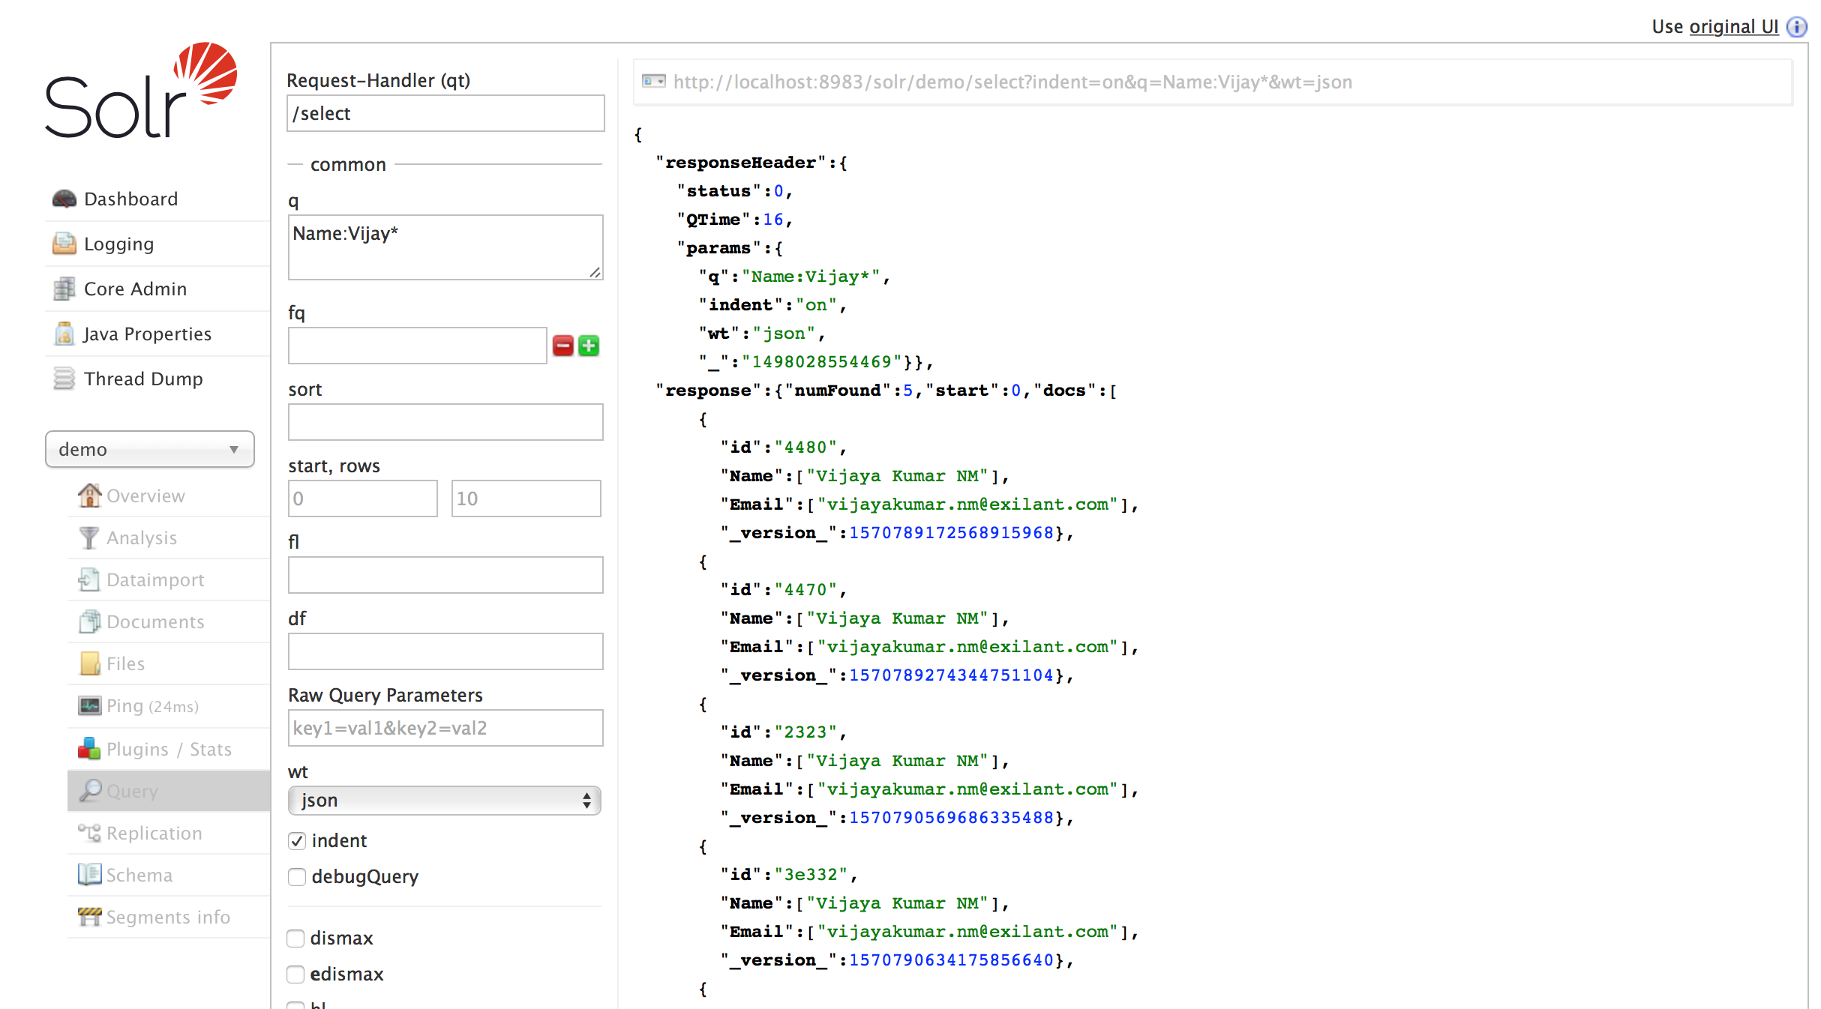
Query Screen

Slide 24
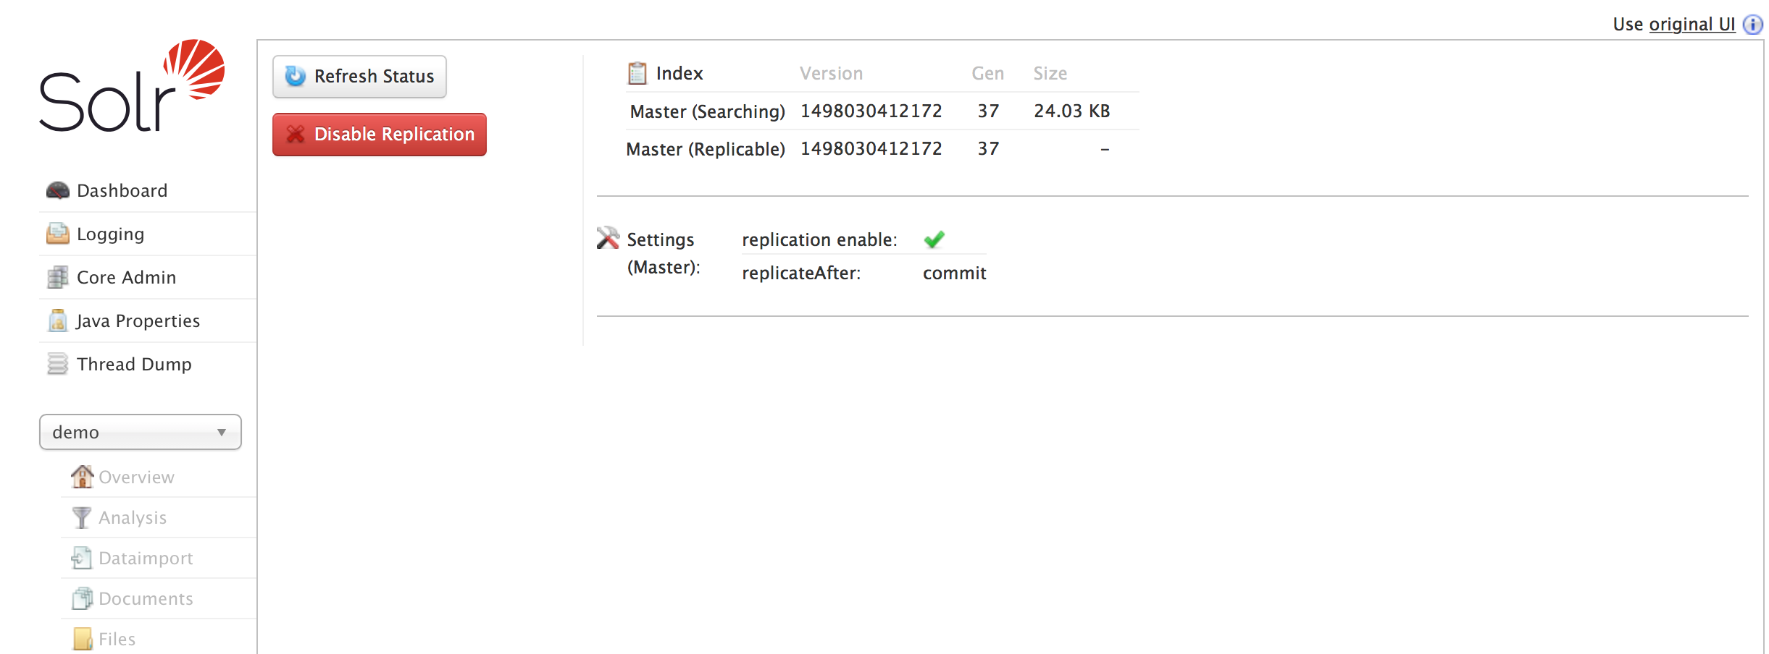
Replication

Slide 25
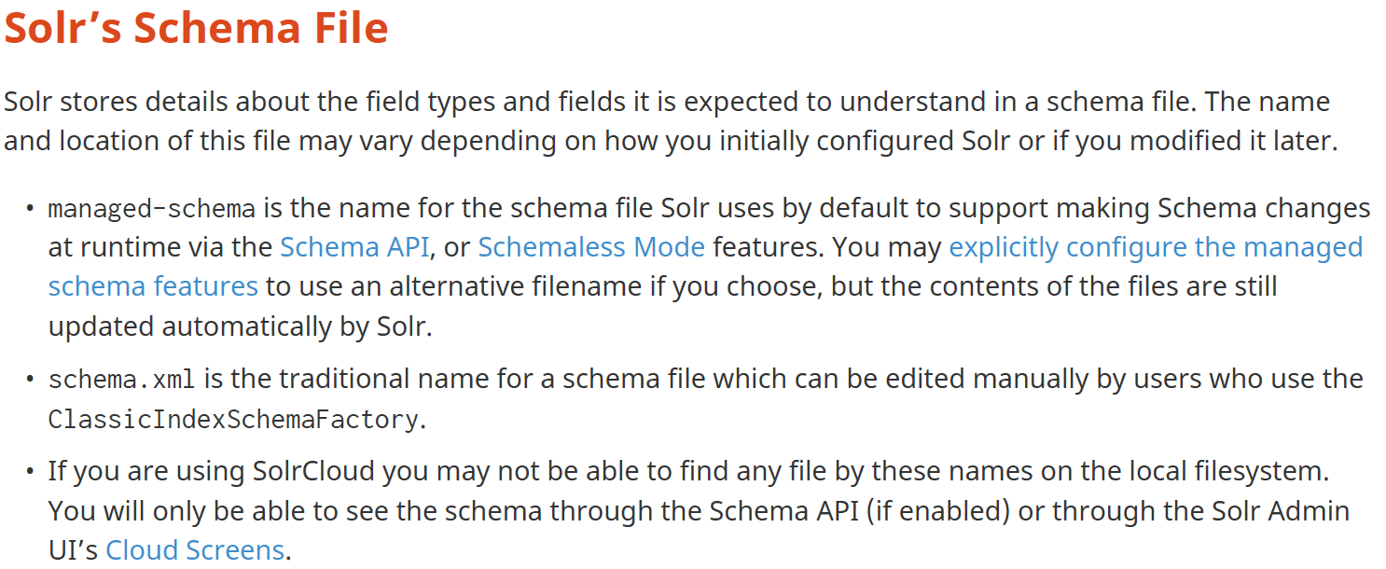

Slide 26
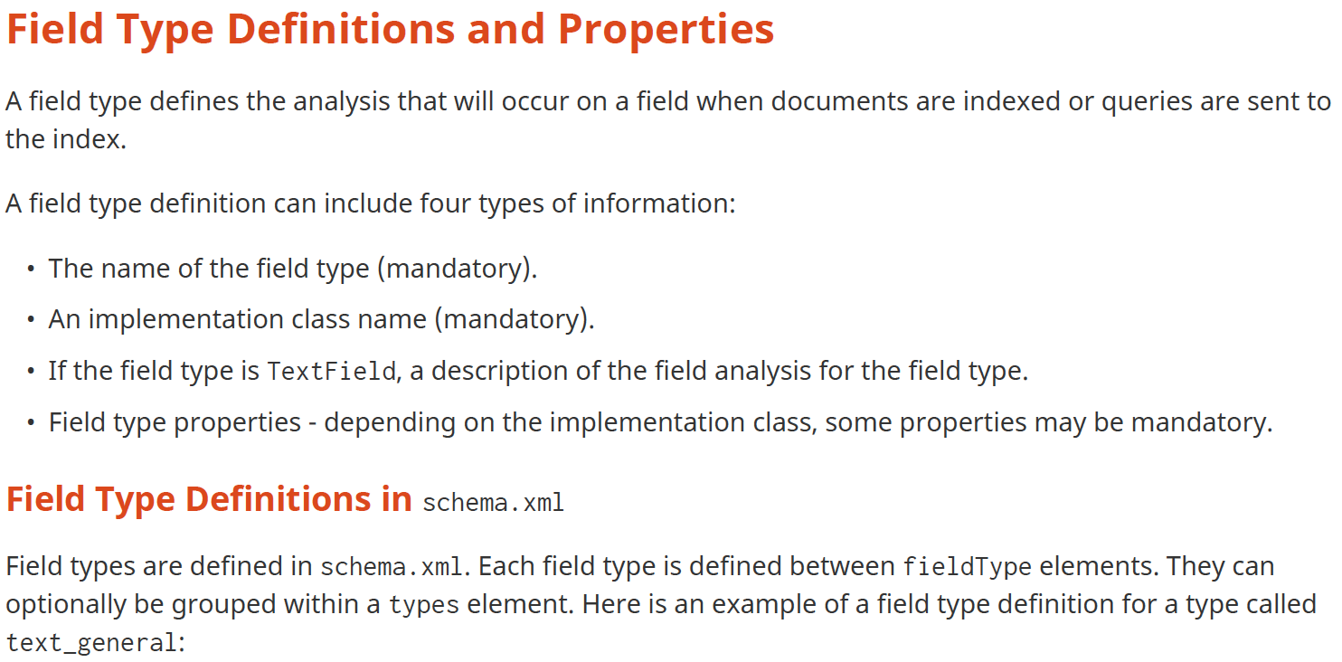

Slide 27
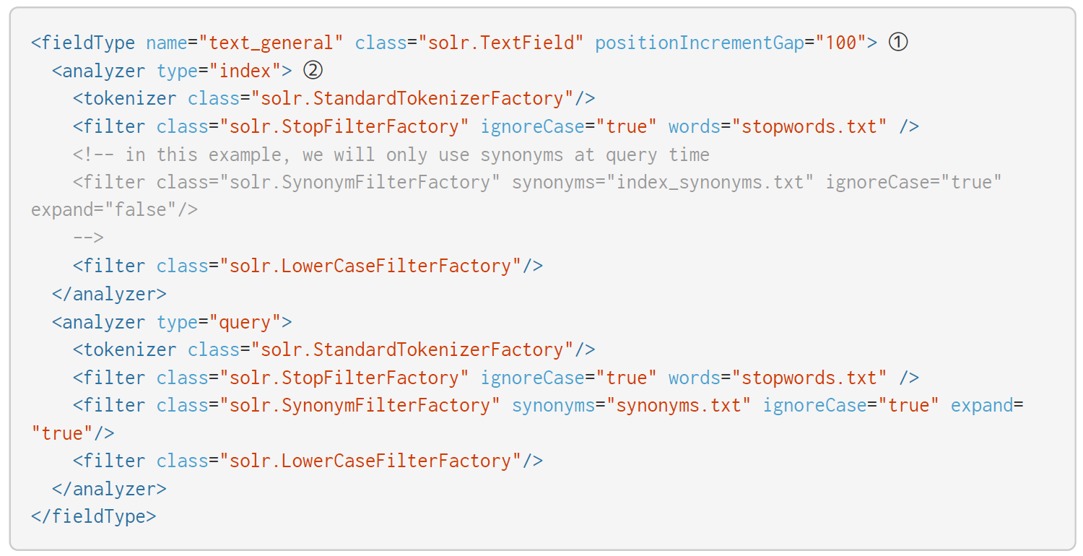

Slide 28
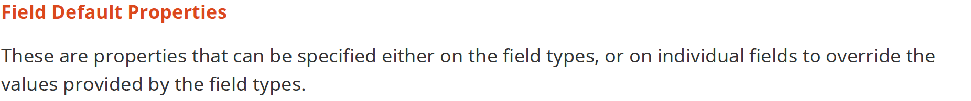
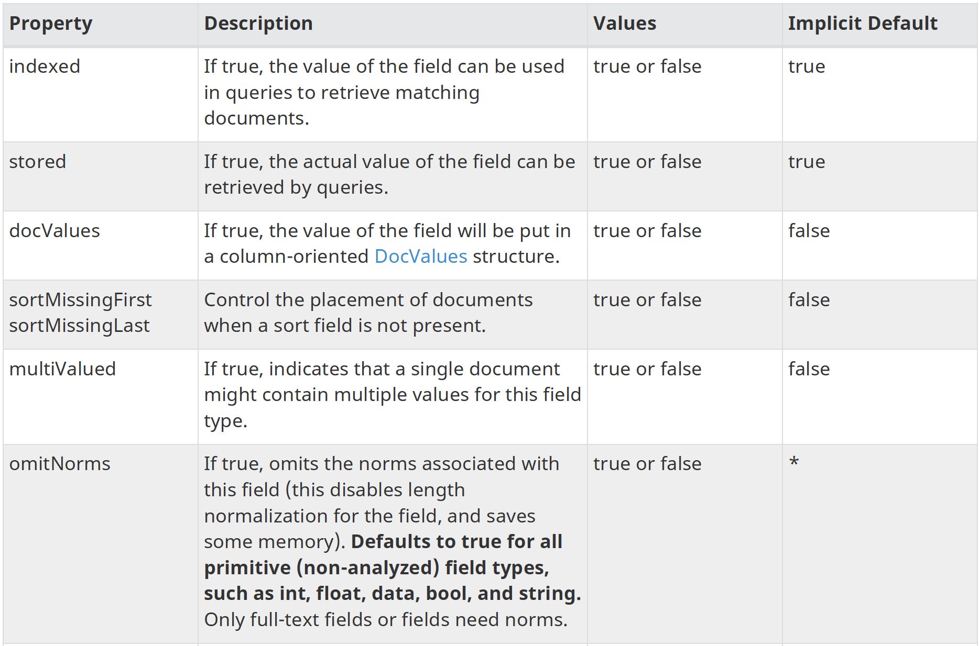

Slide 29
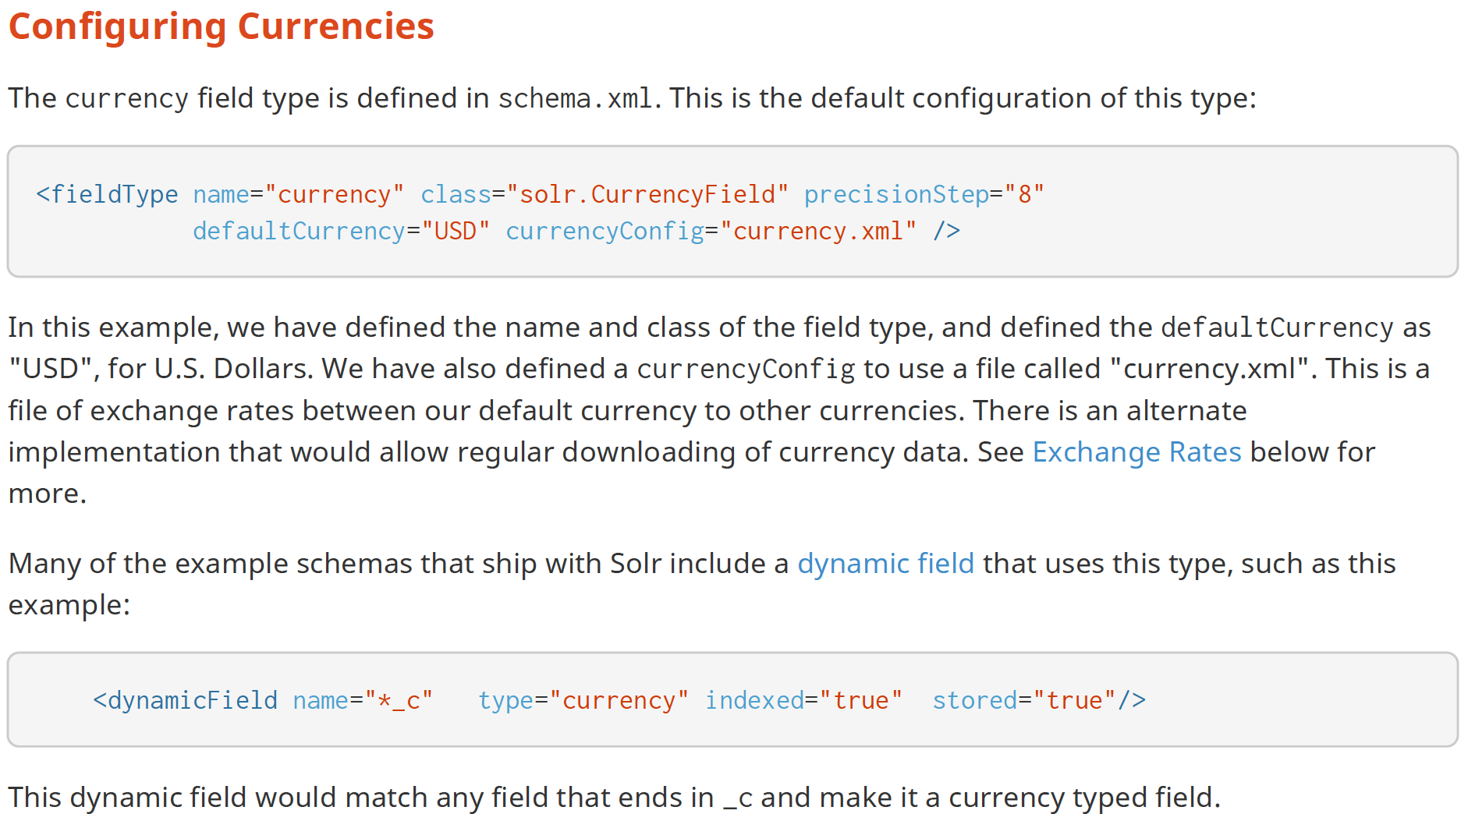

Slide 30
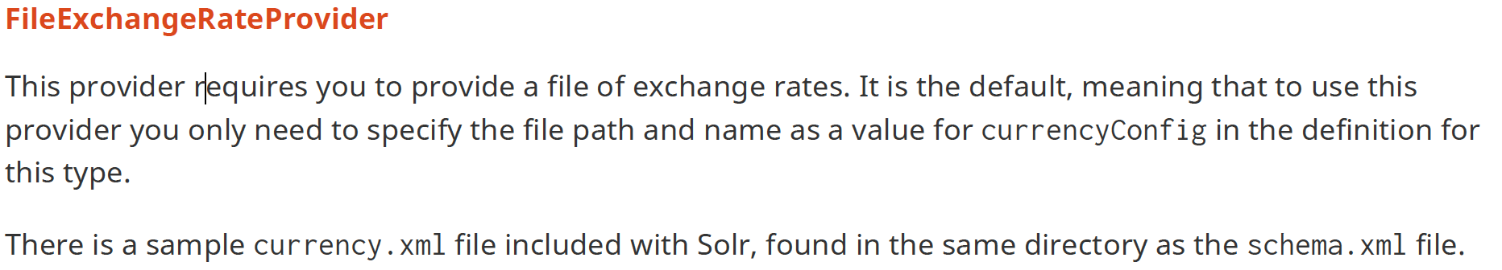
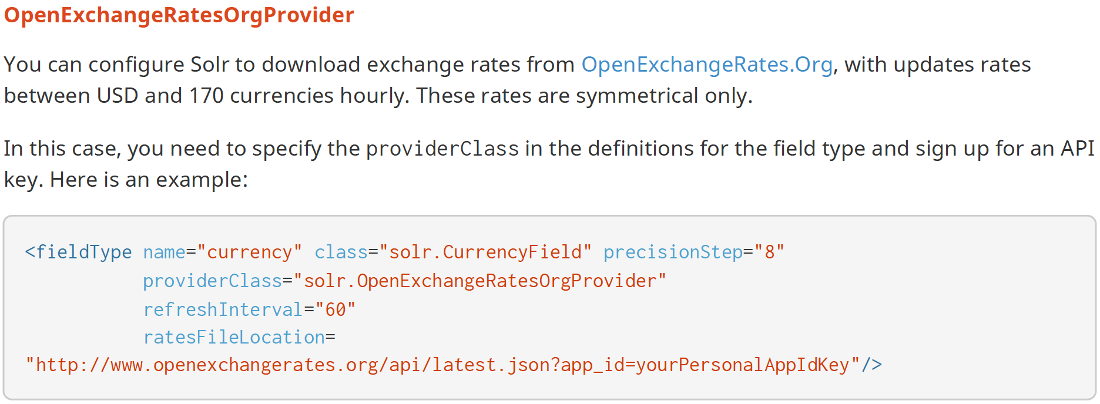

Slide 31
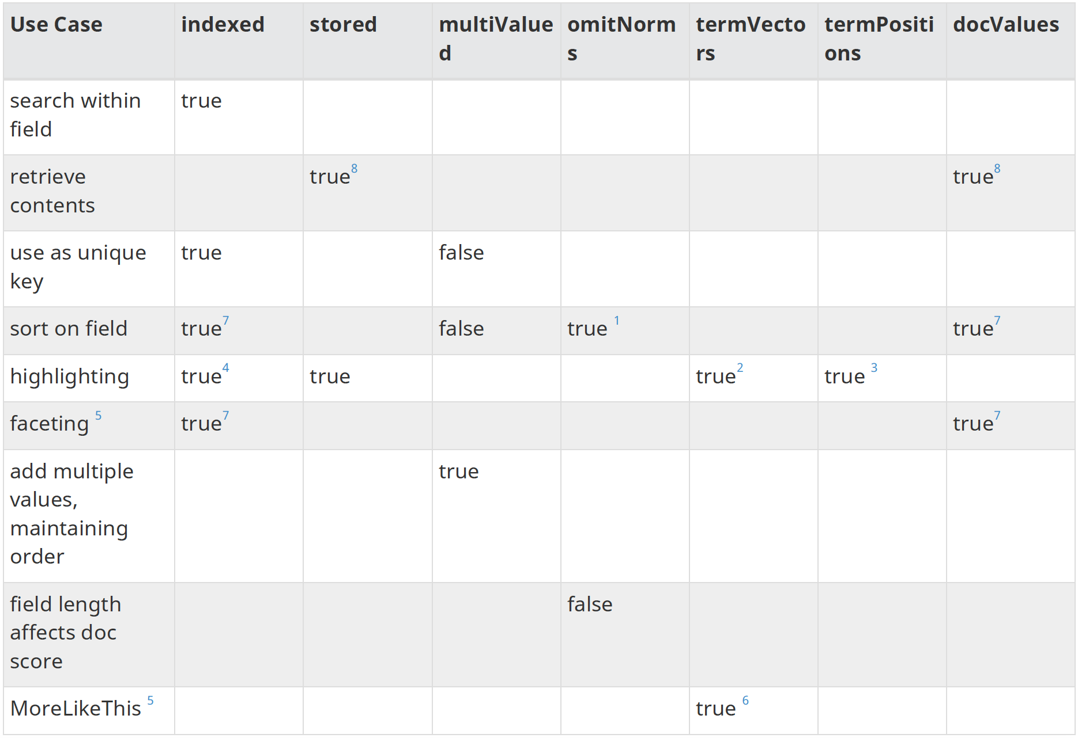

Slide 32
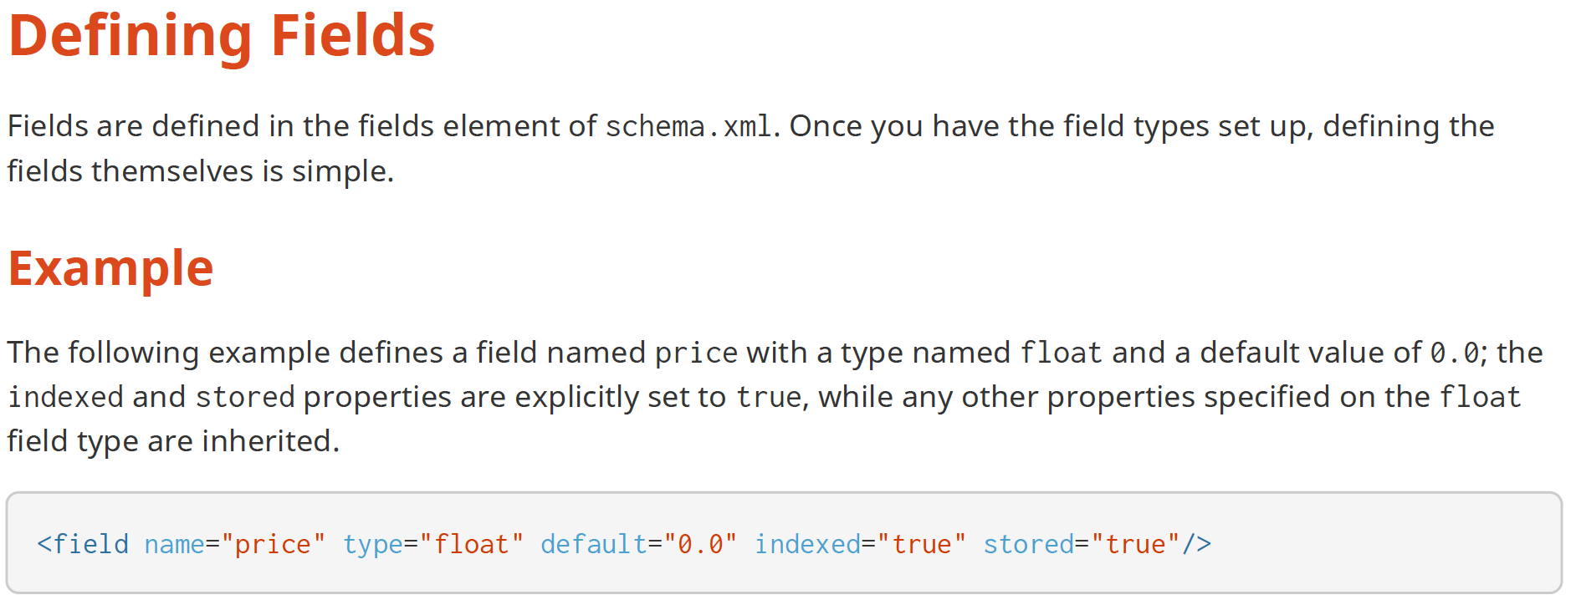

Slide 33
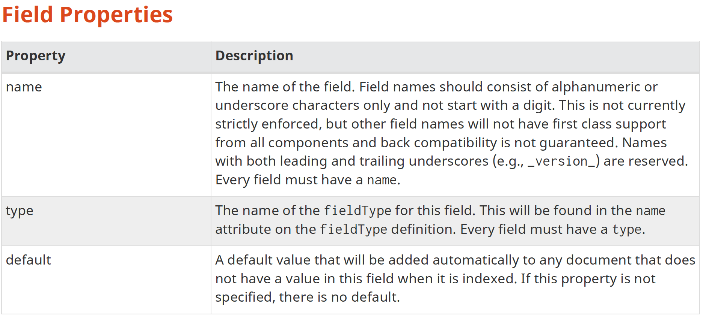

Slide 34
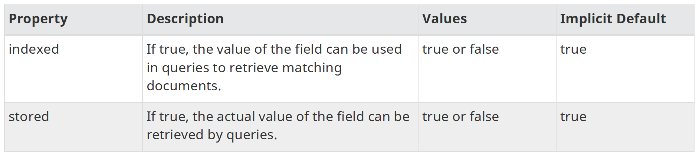
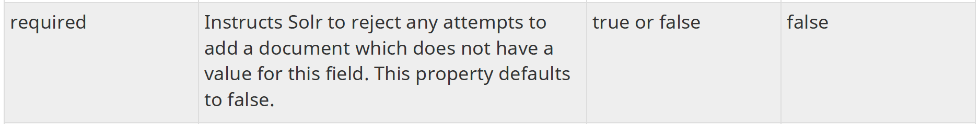
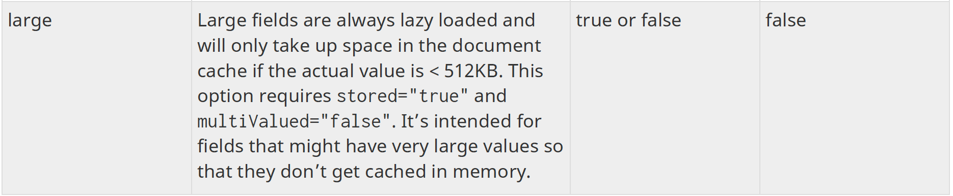

Slide 35
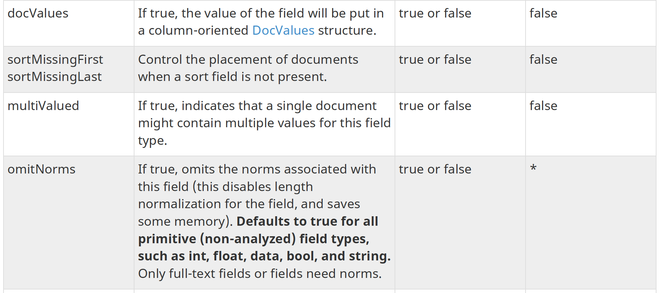

Slide 36
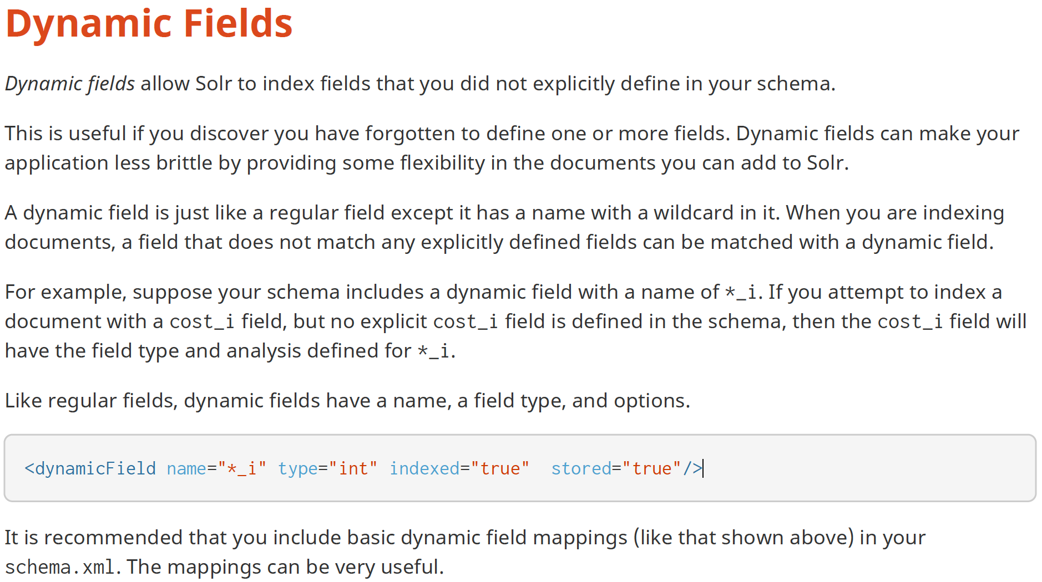

Slide 37


Slide 38
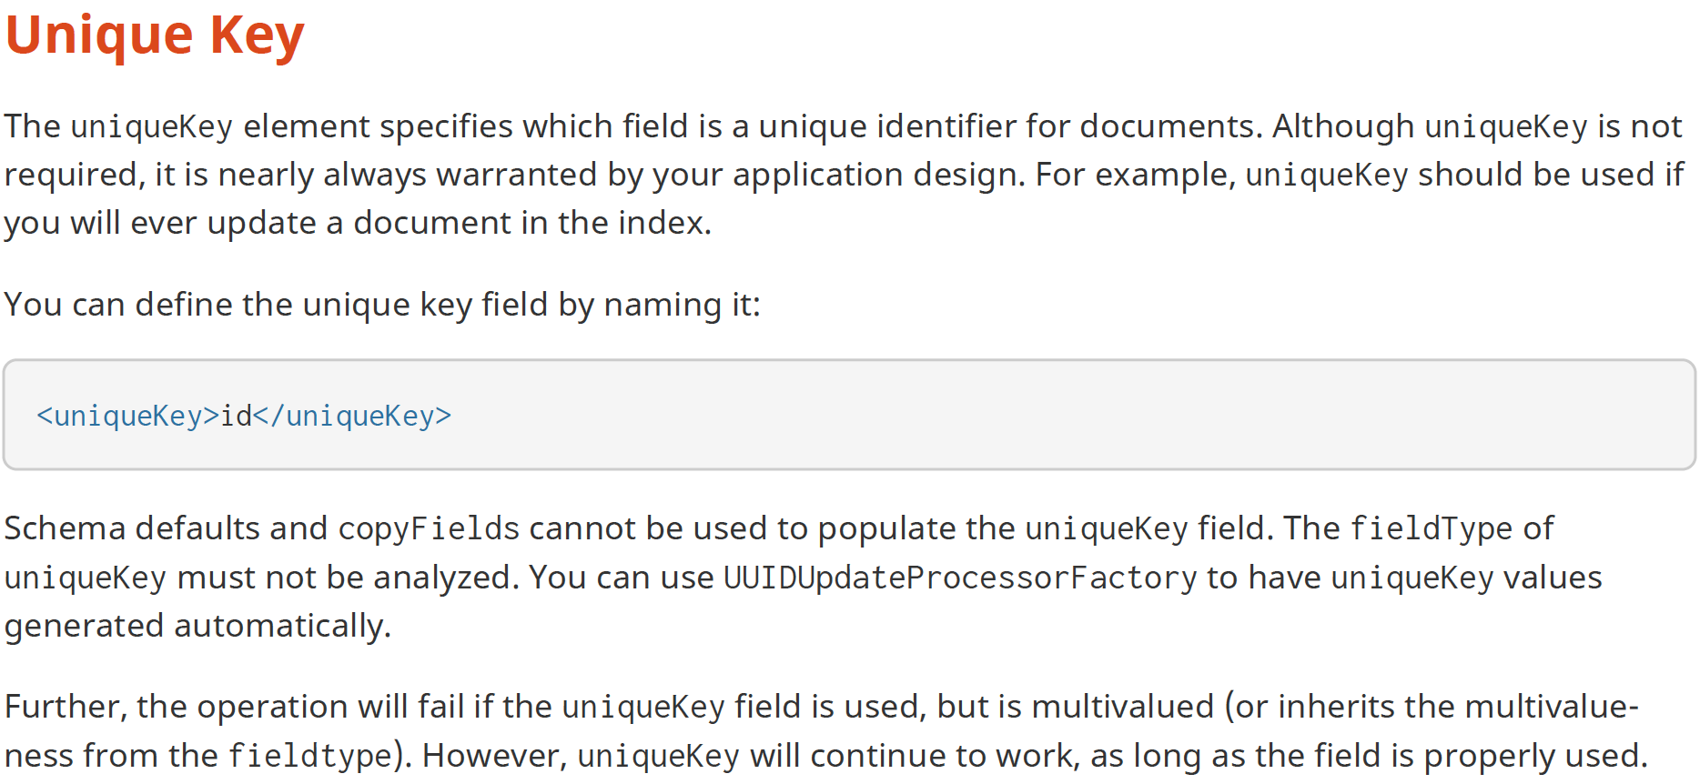

Slide 39


Slide 40
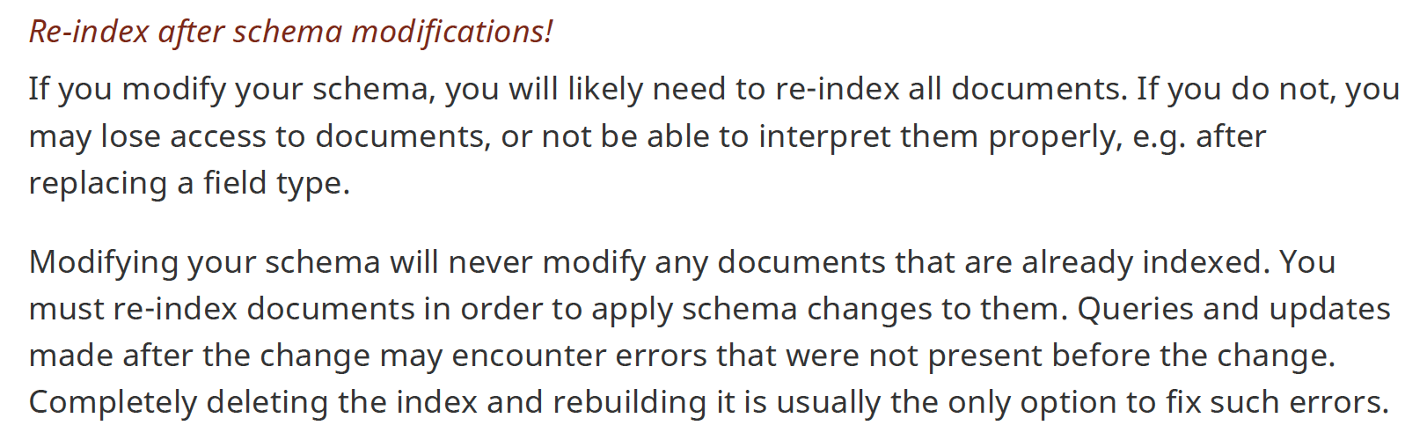

Slide 41
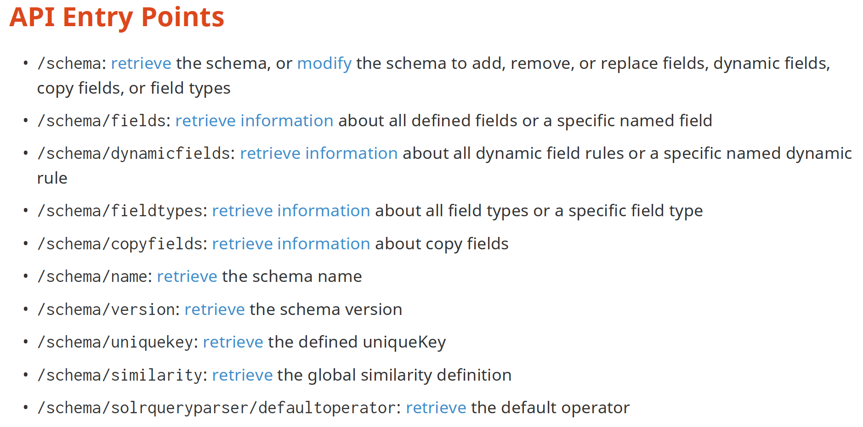

Slide 42
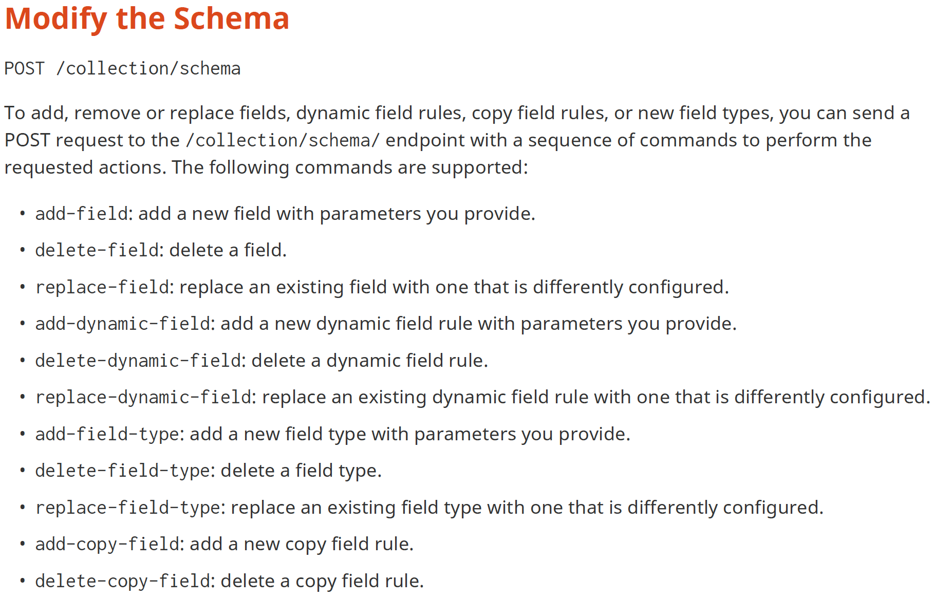

Slide 43
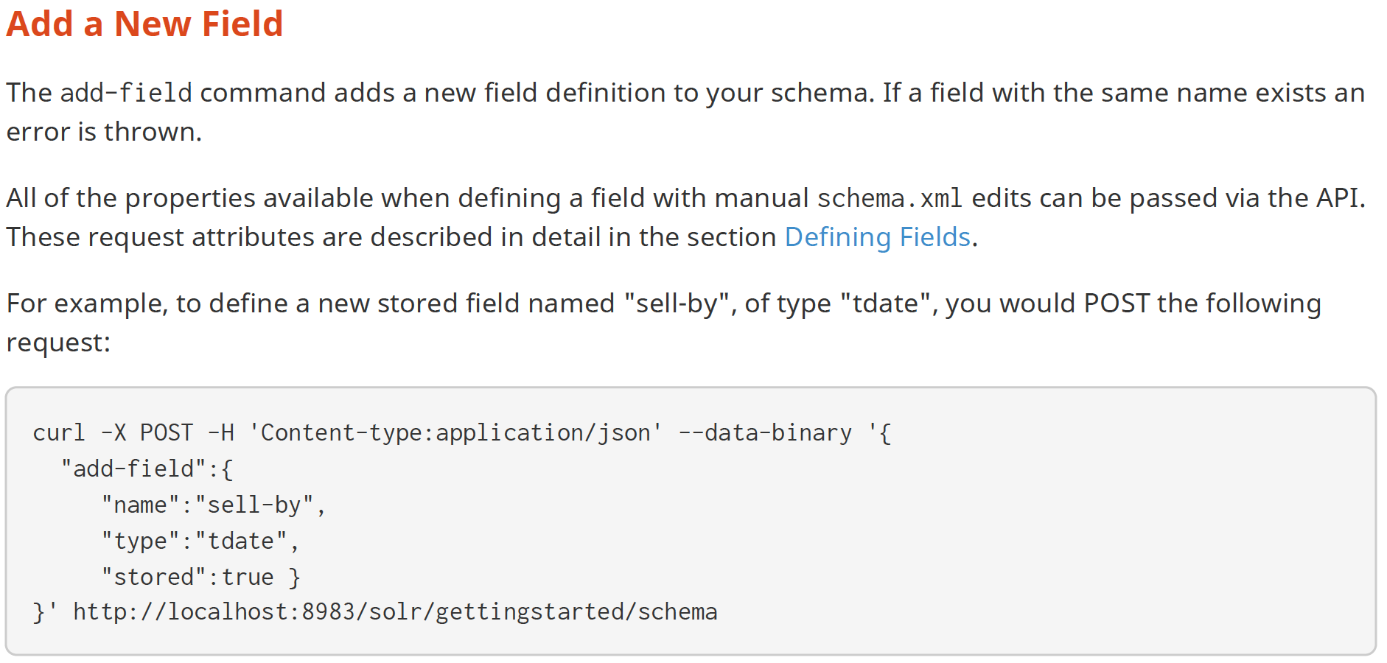

Slide 44
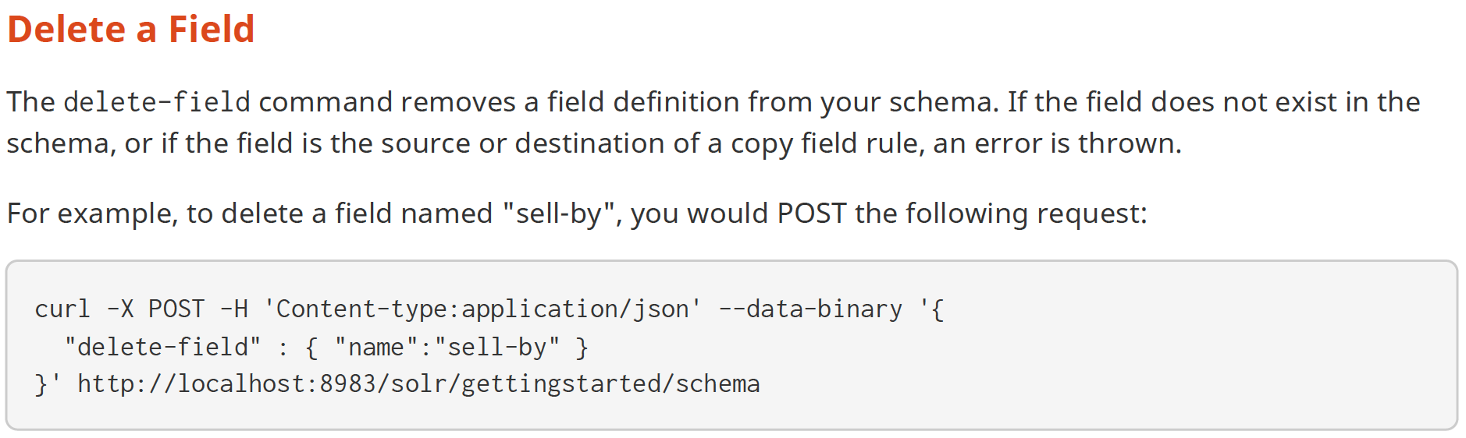

Slide 45
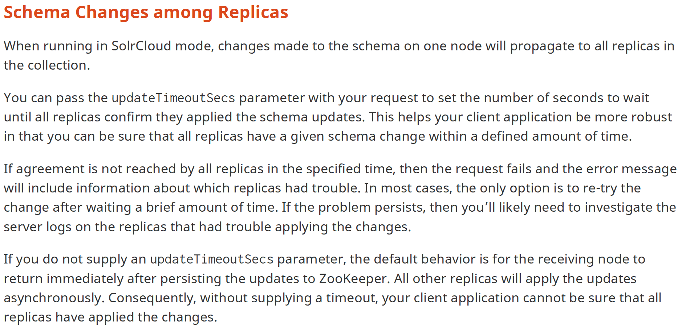

Slide 46
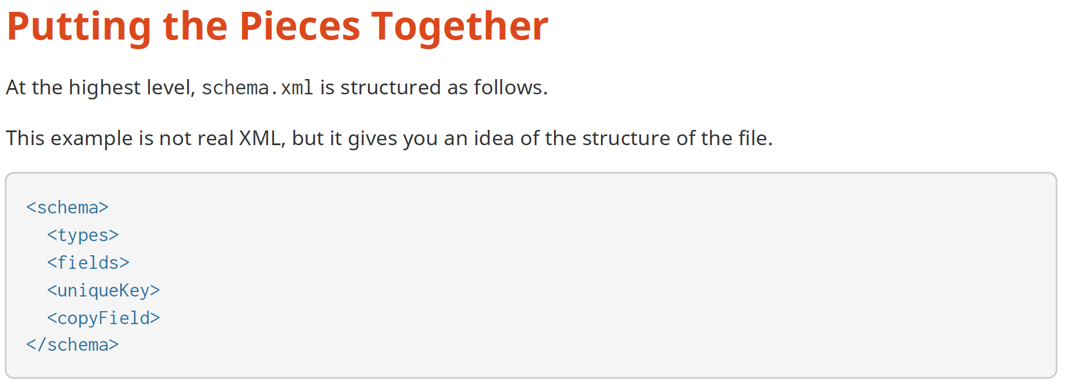

Slide 47
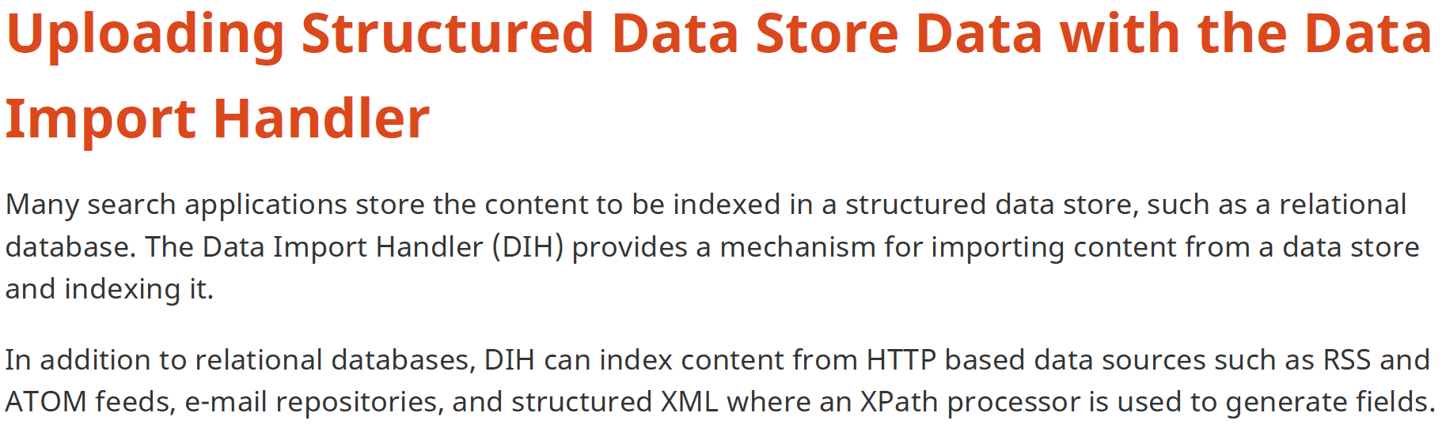

Slide 48
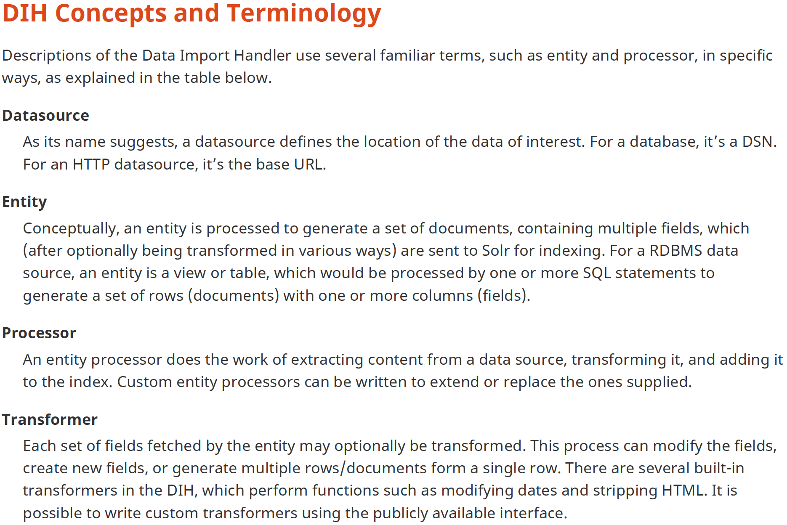

Slide 49
Lab

Slide 50
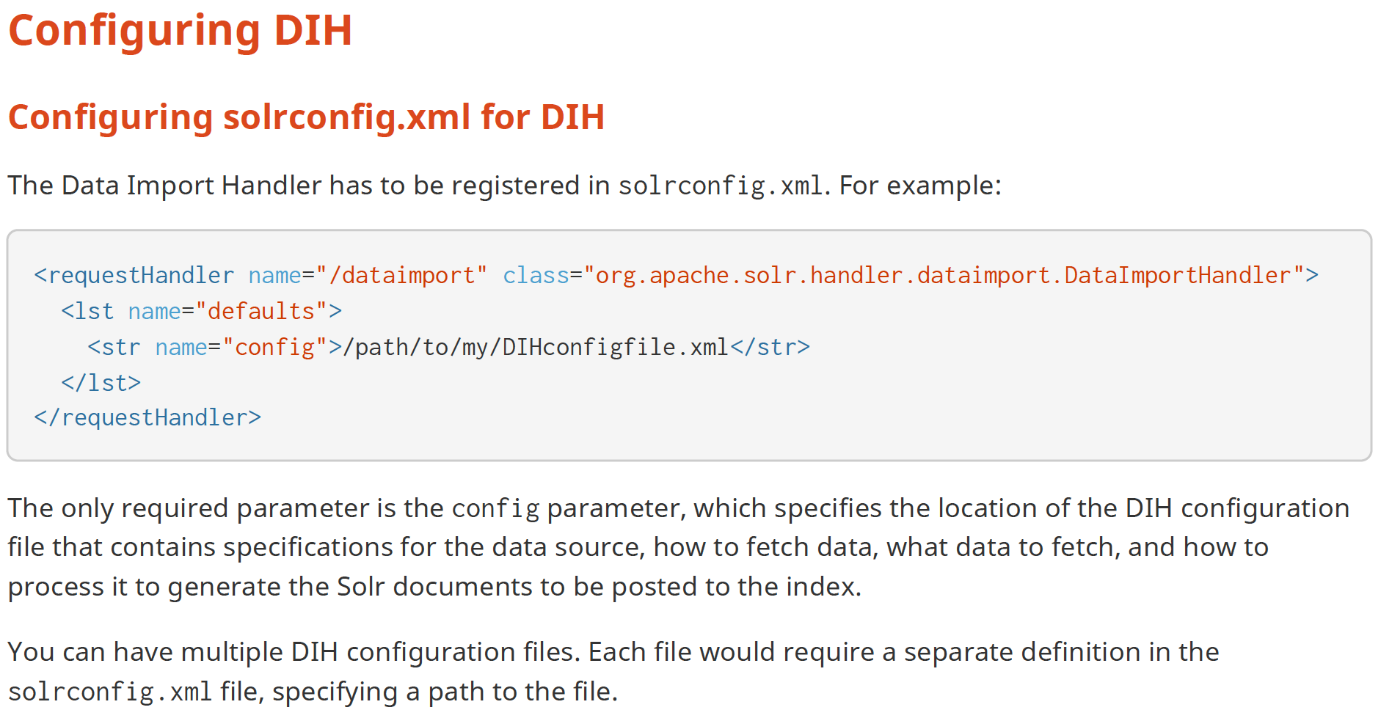

Slide 51



Slide 52


Slide 53
Overview of Searching in Solr
Highlighting
Faceting
Clustering

Slide 54


Slide 55

Ex: Book Recommendation

Slide 56

Legal Search
Recipe Search

Slide 57

Search = “red, medium-sized fruit.”
Precision=3/6=50%
Recall = 3 apples / 5 apples =40%

Slide 58
Dynamic Fields
The “id” field is already pre-defined in every schema. Lucene and Solr need to know the types of fields so that they can be indexed in the correct way. There are a number of options for defining new fields:
Edit the schema.xml file to define the fields.
Use the Schema API to add the new fields.
Use dynamicFields, a form of convention-over-configuration that maps field names to field types based on patterns in the field name. For example, every field ending in “_i” is taken to be an integer.
Use “schemaless” mode, where field types are auto-detected (guessed) based on the first value seen for that field

Slide 59


Slide 60
Thank You

